Slide 1
Biology EOC Review
Session 1: Biochemistry & Cells
Created by: Sandra Spencer (April, 2013)

Slide 2
The “Matter” of Life!
Session 1
All living things are composed of 4 main compounds:
Carbohydrates (think breads, pasta, sugars)
Lipids (think fats, oils, waxes)
Proteins (think bones, hair, skin, enzymes)
Nucleic Acids (think DNA!)

Slide 3

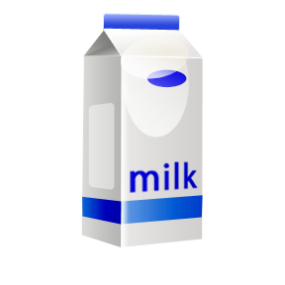
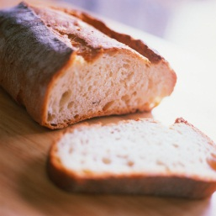
Carbohydrates
Session 1
All carbohydrates have Carbon, Hydrogen, & Oxygen
Made up of monosaccharides (single sugars)
Examples are glucose, sucrose, cellulose, lactose, starch
C₆H₁₂O₆ (Glucose – energy sugar!)

Slide 4
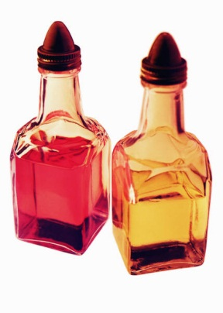

Lipids
Session 1
All lipids have Carbon, Hydrogen, & Oxygen
Made up of fatty acids
Examples are fats, oils, waxes, blubber

Slide 5
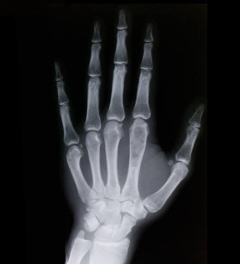
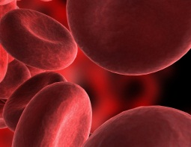
Proteins
Session 1
All proteins have Carbon, Hydrogen, Oxygen, & Nitrogen
Made up of amino acids
Examples are collagen (skin, bones), hemoglobin (blood), microfilaments (muscles, cells), enzymes
Enzymes – act as catalyst (INCREASE speed of reactions)

Slide 6
Nucleic Acids
Session 1
All nucleic acids have Carbon, Hydrogen, Oxygen, Nitrogen, & Phosphorus
Made up of nucleotides
Examples are DNA & RNA

Slide 7
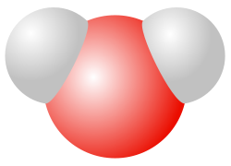
What else ‘Matters’ in Life?
Session 1
WATER!!!
Water makes up approximately 2/3 of every living thing!
Public Domain Image (CC0)

Slide 8
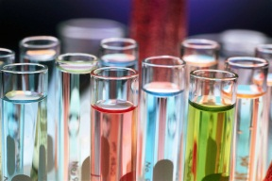
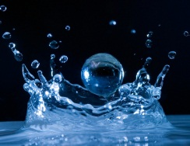
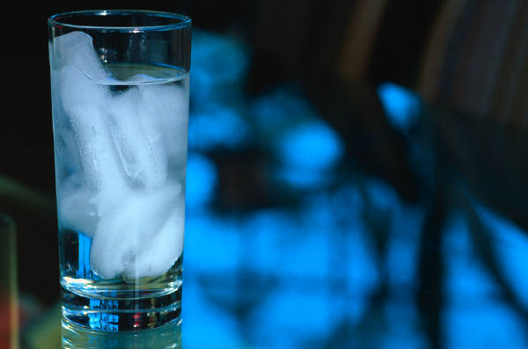
What makes water so essential?
Session 1
Universal Solvent – water is the base of most solutions (think BLOOD!)
Cohesion – water ‘sticks’ to itself and other molecules (think bugs ‘walking on water’, drops, and curved surface in a tube)
Expansion – water EXPANDS as it freezes (think ice floating in soft drink!)
Moderates Temperature – water is slow to heat and slow to cool (think pools in spring/fall)

Slide 9
Now It’s All About CELLS!
The Basic Unit of LIFE!
Session 1
The Cell Theory
All living things are composed of one or more cells
All cells come from other cells
Cells are the smallest unit of life

Slide 10
How do we know?
Session 1
Scientific Method & Microscopes!

Slide 11
Scientific Method
Session 1
Question
Research/Think
Hypothesize (come up with possible solution)
Test & Observe
Analyze (think about observations)
Conclude

Slide 12
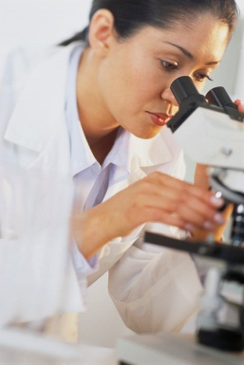
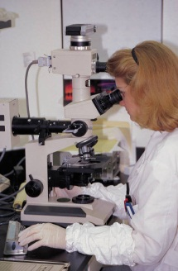
Microscopes
Microscopes
Session 1
Light Microscope – view LIVING & nonliving things, small, cheap, uses light, up to 1000x magnification (see individual cells)
Electron Microscopes – view NONliving things only, large, expensive, up to 1000000x (see individual compounds and atoms)

Slide 13
…and now back to cells
Session 1
Two types of cells:
Prokaryotic – simple, no complex parts, NO Nucleus (think bacteria)
Eukaryotic – complex, “You carry the Nucleus”, lots of parts (think everything else – plants, animals, fungus, etc.)

Slide 14
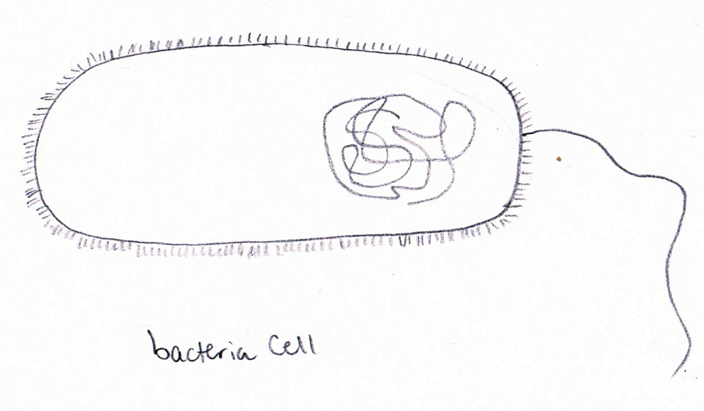
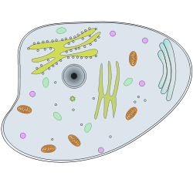
Session 1
Prokaryotic Animal Cell
Eukaryotic Animal Cell
Drawing by S. Spencer (April 2013)
Public Domain Image (CC0)

Slide 15
Cells – Inside and Out
Session 1
(Eukaryotic) Cells are like mini humans – composed of organelles:
Nucleus (brain) Cell membrane (skin/gate)
Cytoplasm (blood) Cytoskeleton (bones)
Lysosome (digestive system)
Mitochondria (Energy/battery)
Golgi Apparatus (UPS) Ribosomes (make proteins)
Chromatin (DNA blueprints)
*Cell Wall (exoskeleton) *Chloroplasts (solar panel)
*Not in animal cells!

Slide 16
A Closer look at the Cell Membrane
Session 1
The “Gate Keeper” – Controlling what comes In & Out
Two Methods:
Passive Transports – no cell energy required, usually moves things from high to low concentration (think a people mover or escalator)
Active Transports – requires cell energy, tends to move things from low to high concentration (think rowing a canoe back upstream against the natural current)

Slide 17
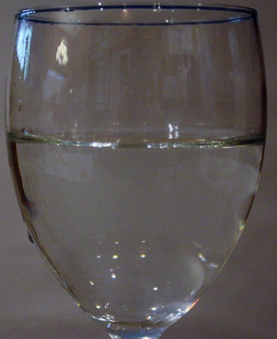
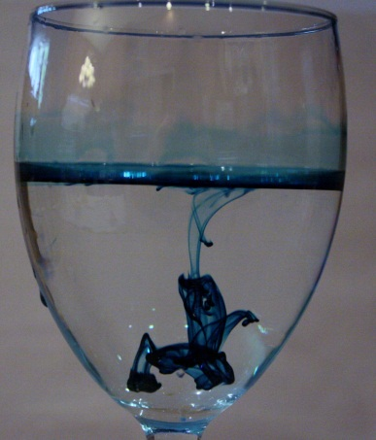
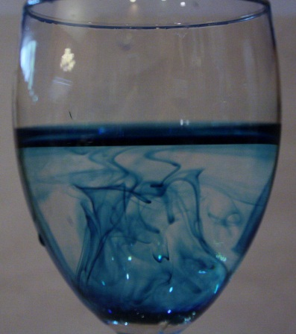
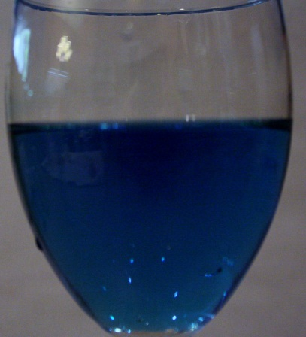
Passive Transports
Session 1
Diffusion – natural, general movement through ‘pores’ in membrane (O2, CO2)

Slide 18
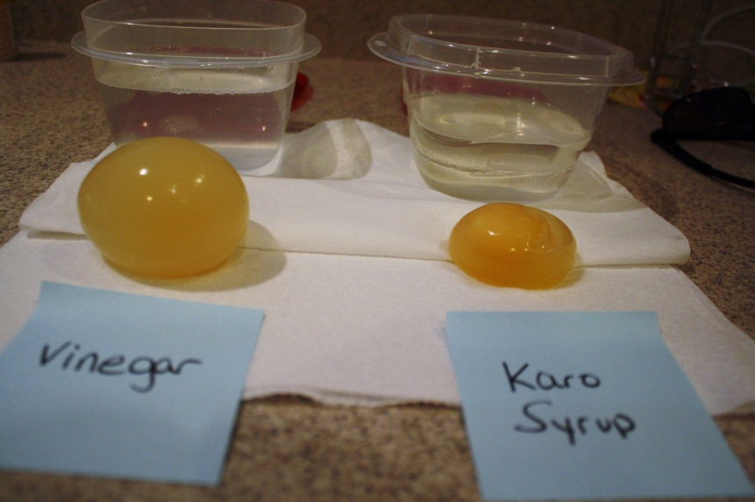
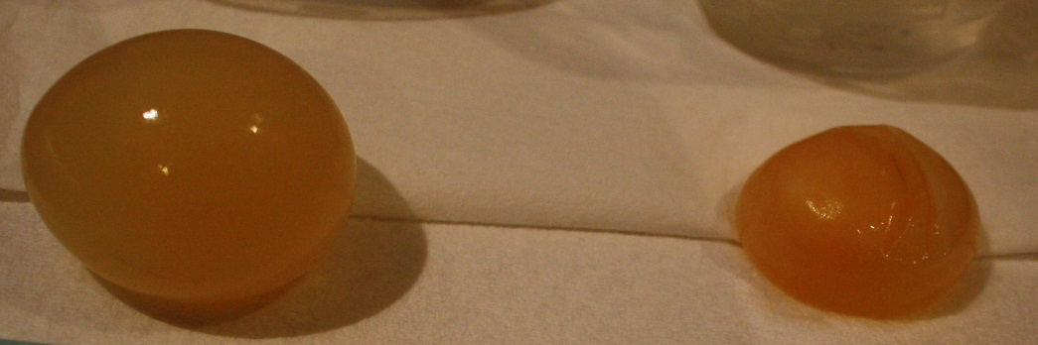
Passive Transports
Session 1
Osmosis – movement of WATER!!

Slide 19
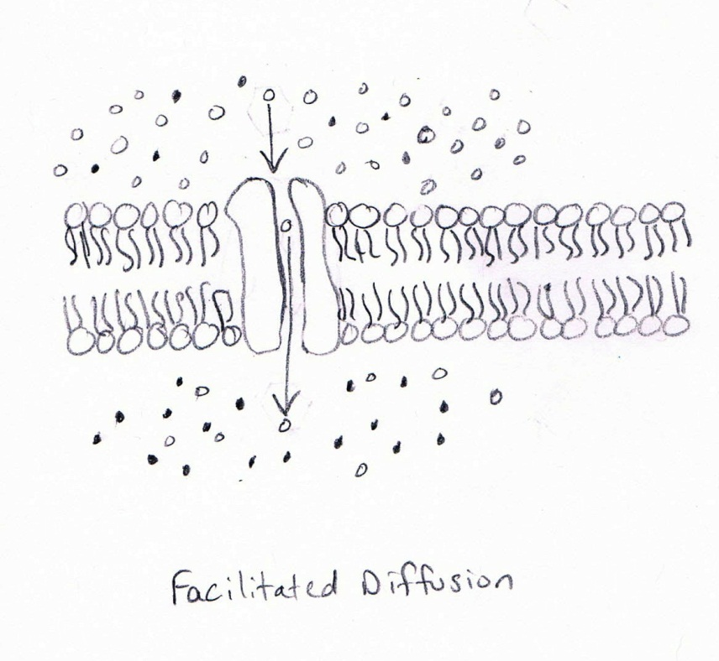
Passive Transports
Session 1
Facilitated Diffusion – movement of larger compounds with a helper protein (glucose)
Drawing by S. Spencer (April 2013)

Slide 20
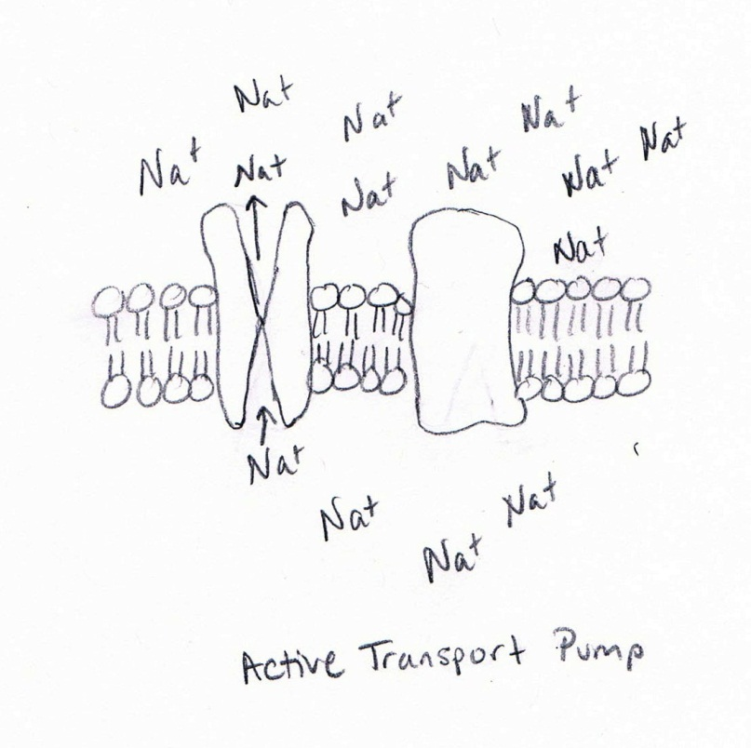
Active Transports
Session 1
Protein Pumps – movement of ions using a pumping protein (Na+, K+)
Drawing by S. Spencer (April 2013)

Slide 21
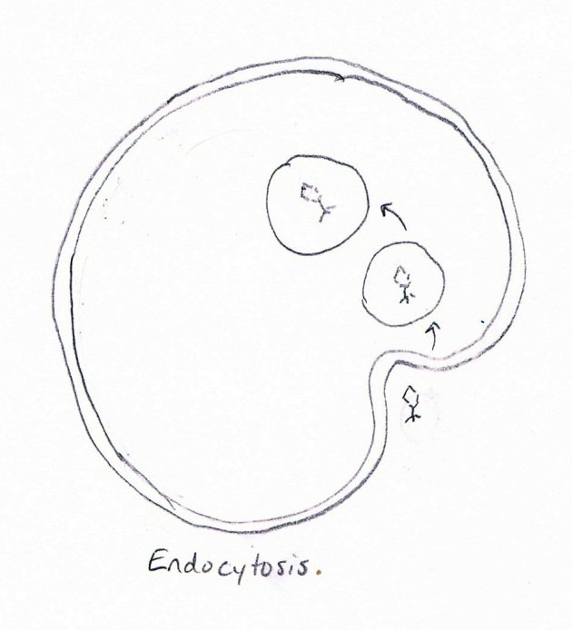
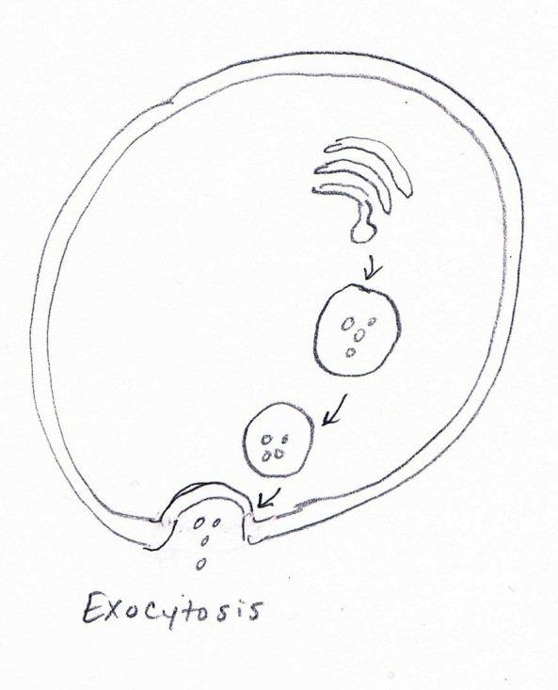
Active Transports
Session 1
Endocytosis – bulk movement INTO cell using vesicles (hormones)
Exocytosis– bulk movement OUT of cell using vesicles (wastes)
Drawing by S. Spencer (April 2013)
Drawing by S. Spencer (April 2013)

