Slide 1
Biology EOC Review
Session 2: Cellular Energy & Cell Division
Created by: Sandra Spencer (April, 2013)

Slide 2
Let’s Get Energized!
Session 2
Energy comes in many different forms
chemical (food)
electrical (plug-ins)
radiant (sun)
All living things must obtain and use energy!

Slide 3
Session 2
Heterotrophs (Consumers): Obtain food energy (glucose) through consumption (animals, fungus)
Autotrophs (Producers): Obtain food energy (glucose) through Photosynthesis (plants, bacteria)

Slide 4
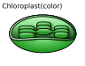
Photosynthesis
Session 2
The conversion of solar energy to food energy (glucose).
6CO₂ + 6H₂O → 6O₂ + C₆H₁₂O₆
carbon dioxide + water oxygen + glucose
*Takes place in the chloroplast!
sunlight
Public Domain Image (CC0)

Slide 5
Photosynthesis: 2 stages
Session 2
sunlight
6CO₂ + 6H₂O → 6O₂ + C₆H₁₂O₆
carbon dioxide + water oxygen + glucose
Light Reactions
Calvin Cycle (Dark Reactions)

Slide 6
We have Glucose…Now what???
Session 2
C₆H₁₂O₆(glucose) is a ‘raw’ form of chemical energy that must be transferred to a usable form (ATP)
Illustrative Example:
The cell is like a soda machine.
Glucose is like a debit card.
The soda machine can’t use a debit card even though it represents cash, just like a cell can’t use glucose even though it represents chemical energy.

Slide 7
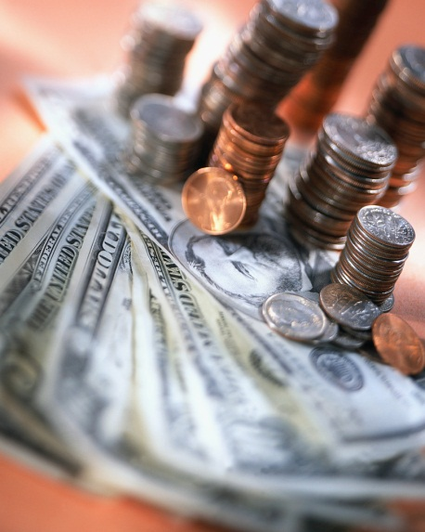
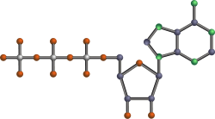
ATP (Adenosine Triphosphate)
Session 2
Cells must use ATP, much like the soda machine must use CASH or COINS!
ATP
*Soda machines use CASH to dispense sodas; cells use ATP to move materials, make proteins, etc.
Public Domain Image (CC0)

Slide 8
Cellular Respiration
Session 2
ALL cells (plants, animals, fungus, etc.) must convert Glucose to ATP in a process known as Cellular Respiration!
Two Types:
Aerobic Respiration – with oxygen
Anaerobic Respiration – withOUT oxygen

Slide 9
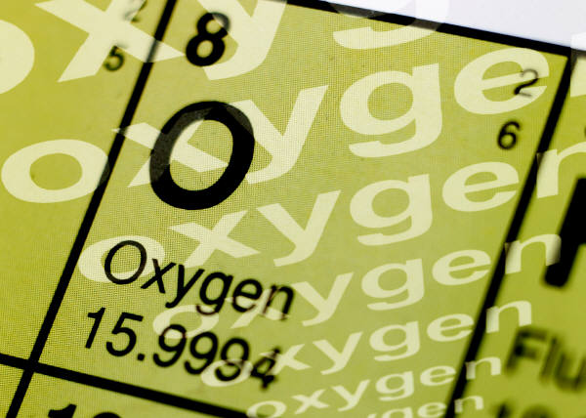
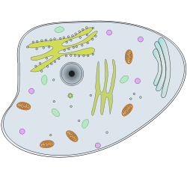
Aerobic Respiration
Oxygen = MORE!
Session 2
6O₂ + C₆H₁₂O₆ → 6CO₂ + 6H₂O + energy
oxygen + glucose carbon dioxide + water + 36ATP
Location: Cytoplasm & Mitochondria
3 steps:
Glycolysis
Krebs Cycle
Electron Transport

Slide 10
Do you see what I see?
Session 2
Sunlight energy + 6CO₂ + 6H₂O → 6O₂ + C₆H₁₂O₆
(Photosynthesis)
6O₂ + C₆H₁₂O₆ → 6CO₂ + 6H₂O + energy
(Aerobic Cellular Respiration)
That’s Right!!! They are exact opposites!

Slide 11

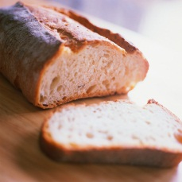
Anaerobic Respiration
No Oxygen = LESS
Session 2
When oxygen is NOT available, Glucose is converted to only 2 ATP by FERMENTATION.
Alcoholic Fermentation – used by microorganisms (think yeast, bread, beer)
Lactic Acid Fermentation – used by
animals (think sore muscles – ouch!)

Slide 12
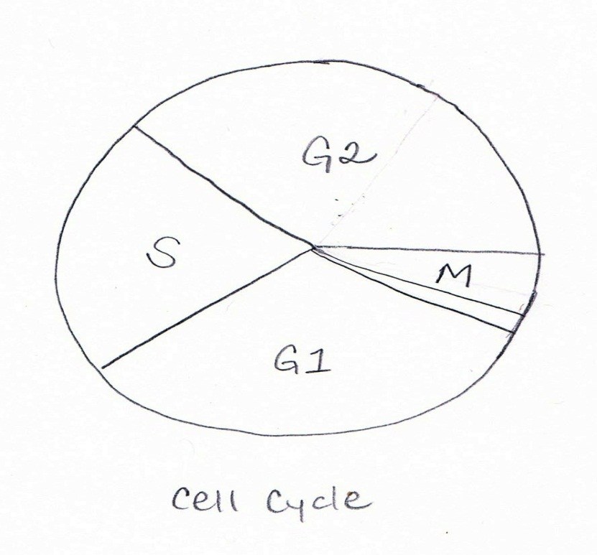
Now that we have ENERGY…
LET’S GET TO WORK – Growing & Dividing!
Session 2
Cell Cycle (think Life Cycle)
G1, S, G2 = Interphase
M = Division (mitosis or
meiosis)
Cytokinesis = cell separation
Drawing by S. Spencer 2013

Slide 13
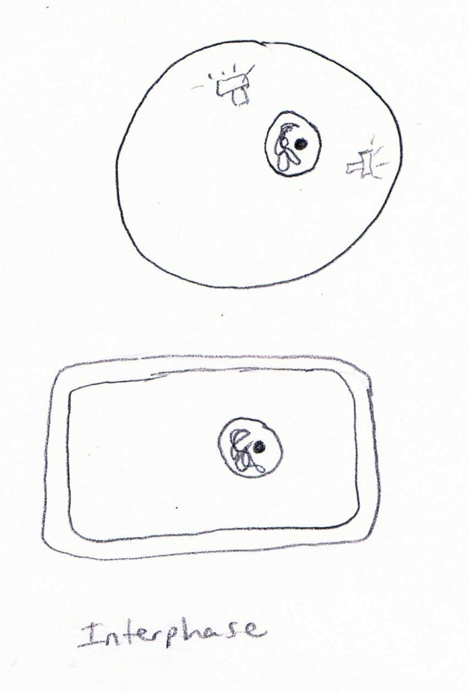
Interphase
Session 2
G1 – general growth
S – synthesis (copying) of chromosomes
G2 – preparation for division
Drawing by S. Spencer 2013

Slide 14
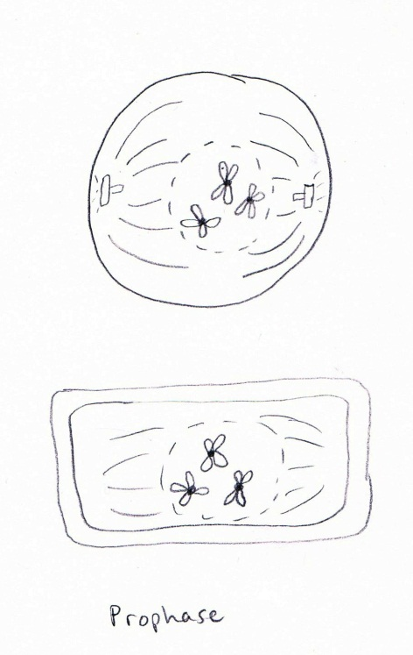
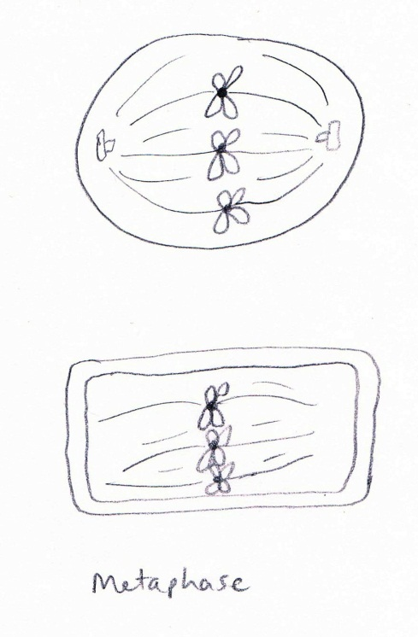
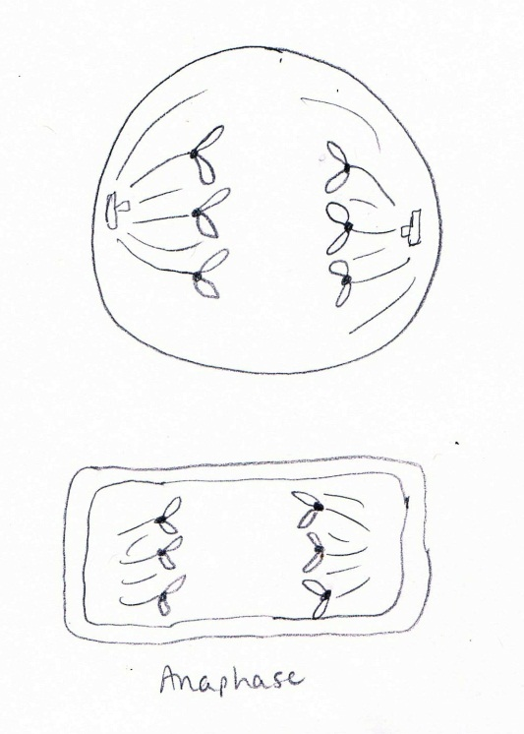
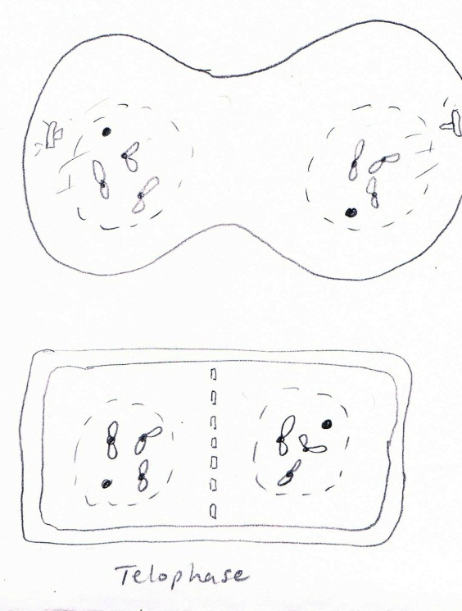
Cell Division – Mitosis
Asexual reproduction forming 2 identical cells
(Division occurs in most ‘body’ cells for growth & repair)
Session 2
Prophase – condensing of chromosomes, disappearance of nuclear membrane & nucleolus, spindle fibers form
Metaphase – chromosome pairs line up in middle of cell
Anaphase – chromosome pairs are pulled apart to opposite sides of cell
Telophase – 2 new nuclear membranes reform on either end of cell, chromosomes begin to uncoil
Drawings by S. Spencer 2013

Slide 15
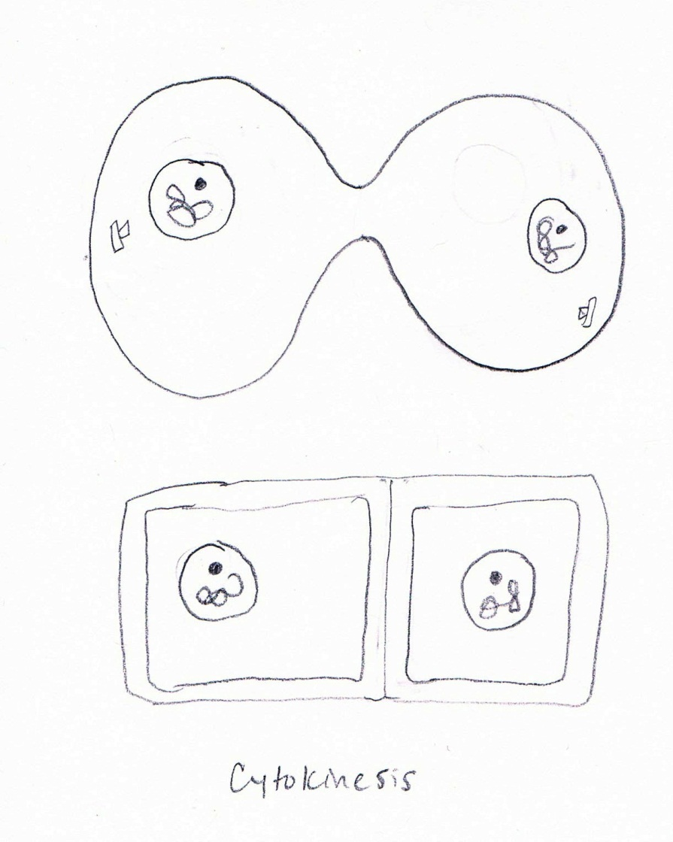
Cytokinesis
Session 2
Final separation of new cells formed during division.
Cleavage furrow
Cell Plate
Drawing by S. Spencer 2013

Slide 16
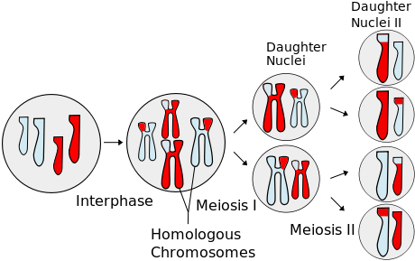
Cell Division – Meiosis
Division forming 4 different cells (each having HALF the original # of chromosomes)
Session 2
Public Domain Image (CC0)
2 Divisions back to back
Cells produced are HAPLOID (half the # of chromosomes)
Division only used in cells involved in SEXUAL reproduction (they are GAMETES – sex cells)
Crossing Over

Slide 17
Let’s Compare
Session 2
Mitosis | Meiosis
Reproduction – Asexual | Reproduction – Sexual
1 Division | 2 Divisions
2 Daughter Cells | 4 Daughter Cells
Produces Identical Cells | Produces Different Cells
Produces Diploid Cells | Produces Haploid Cells
Non-sex cells | Sex cells
Limits Genetic Diversity | Increases Genetic Diversity

Slide 18
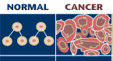
Now you’re getting
Out of Control!
Session 2
The cell cycle is controlled by CYCLINS.
Cell Division that is uncontrolled = CANCER
Public Domain Image (CC0)

