Slide 1
Biology EOC Review
Session 3: DNA & Genetics
Created by S. Spencer (April 2013)
All images are Microsoft Clipart used with permission from Microsoft, Inc, unless otherwise noted.

Slide 2
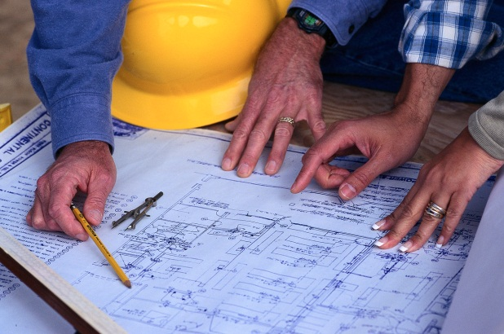

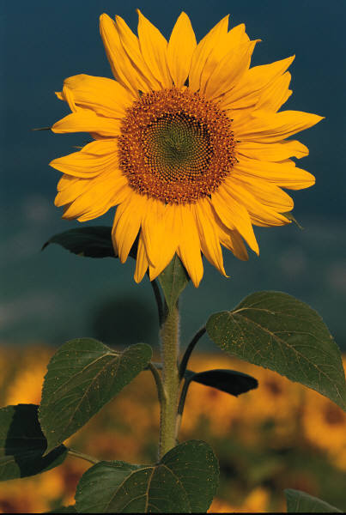
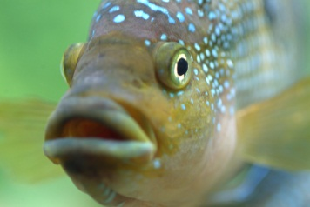
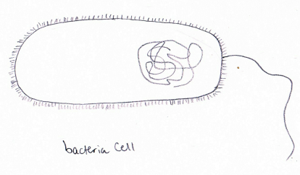
It’s all based on DNA!
Session 3
DNA
Blueprints
OR
OR
OR
Drawing by S. Spencer (April 2013)

Slide 3
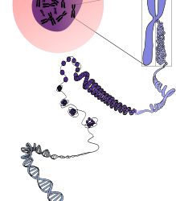
Quick Review!
Session 3
DNA is found inside the chromatin (chromosomes)
DNA is made up of nucleotides.
DNA is a double helix.
Public Domain Image (CC0)

Slide 4

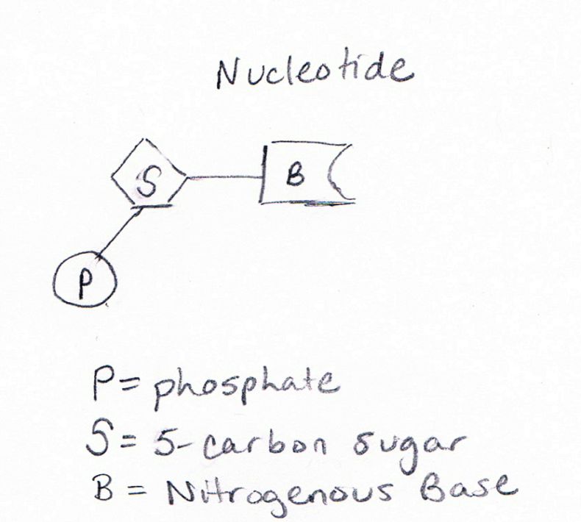
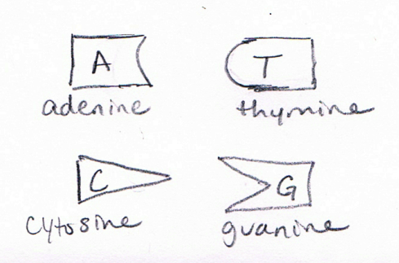
Let’s take a closer look!
Session 3
1 nucleotide =
5 carbon sugar (deoxyribose) + phosphate + nitrogenous base
Nitrogenous Bases:
Adenine Thymine
Cytosine Guanine
Drawing by S. Spencer (April 2013)
Drawing by S. Spencer (April 2013)

Slide 5
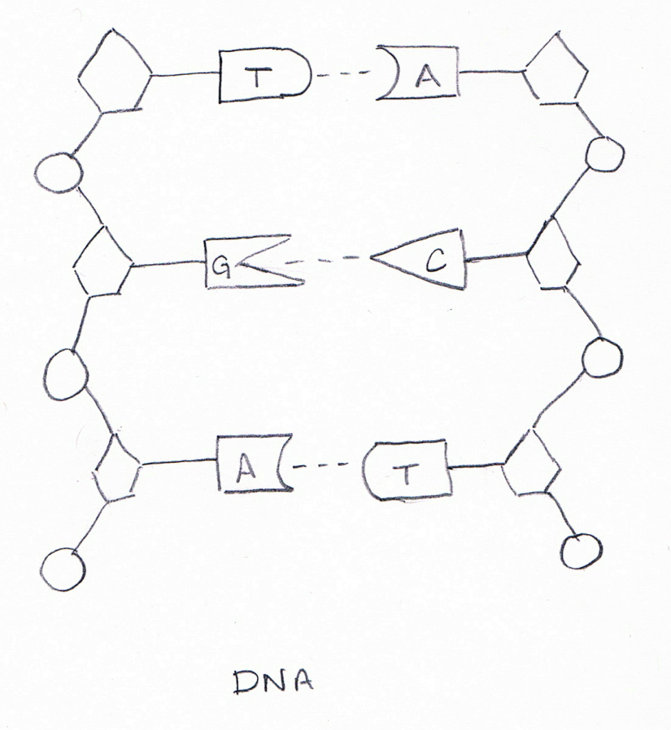
Nucleotide + Nucleotide + Nucleotide + Nucleotide….= DNA
Session 3
Notice the COMPLIMENTARY BASE PAIRING!
A matches T
C matches G
Drawing by S. Spencer (April 2013)

Slide 6
Quick Check!
Session 3
What would be the complimentary bases to the following strand of DNA nucleotides?
ATCCGATTG
That’s Right!
TAGGCTAAC

Slide 7
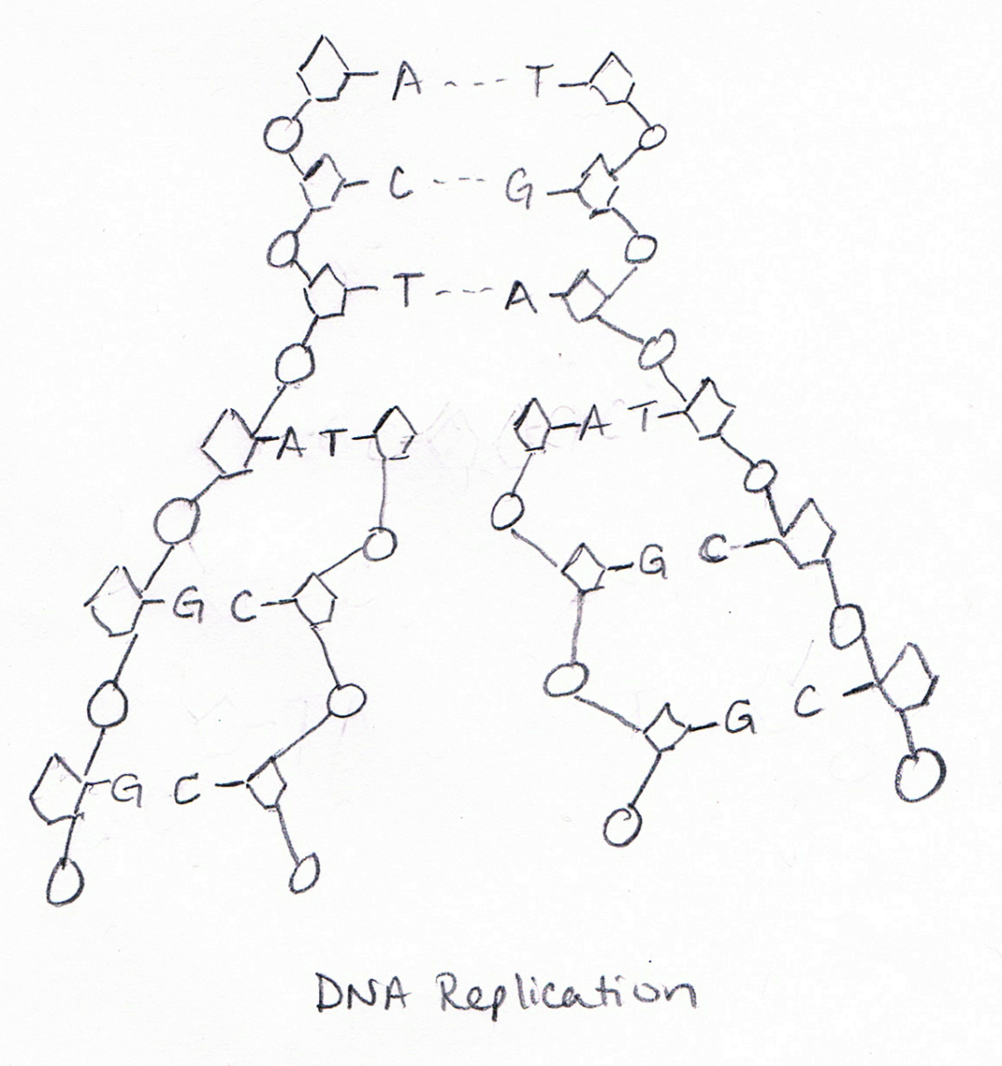
How do new cells get the DNA?
Session 3
DNA Replication
Before cell division, DNA helix unwinds and splits apart.
New nucleotides come in, matching the opened DNA sides
Two DNA helixes are formed (each with half old and half new)
original
new
new
Drawing by S. Spencer (April 2013)

Slide 8
Now let’s turn these ‘blueprints’ into a ‘house’ (…’DNA’ into ‘Proteins’)
Session 3
Protein Synthesis:
Making proteins from DNA
Two Steps:
Transcription
Translation

Slide 9
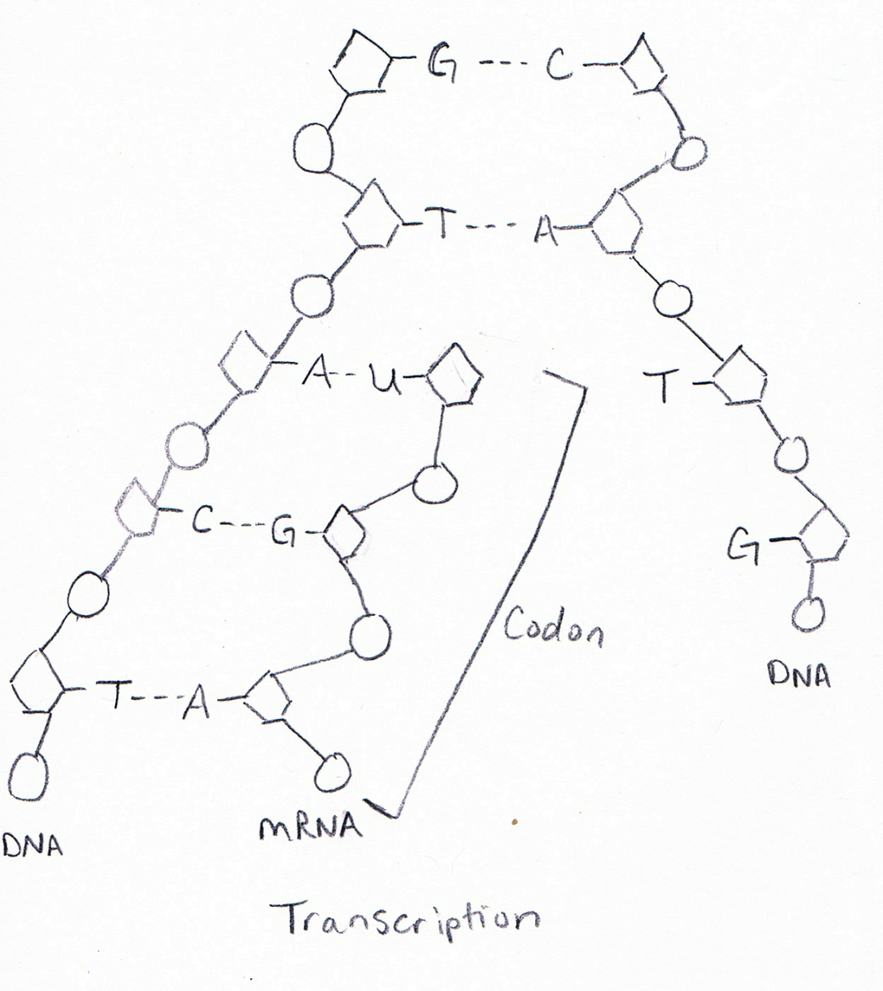
Transcription
Session 3
DNA helix unwinds and splits apart.
New nucleotides come in, forming a messenger RNA (mRNA) strand
The mRNA strand detaches, leaves the nucleus, and goes to a ribosome in the cytoplasm
Drawing by S. Spencer (April 2013)

Slide 10
REMINDER!!!!
Session 3
mRNA
Nucleic Acid
Single strand of nucleotides
Adenine, URACIL, guanine, cytosine
A matches U DNA: ATCCGATTG
G matches C mRNA: UAGGCUAAC

Slide 11
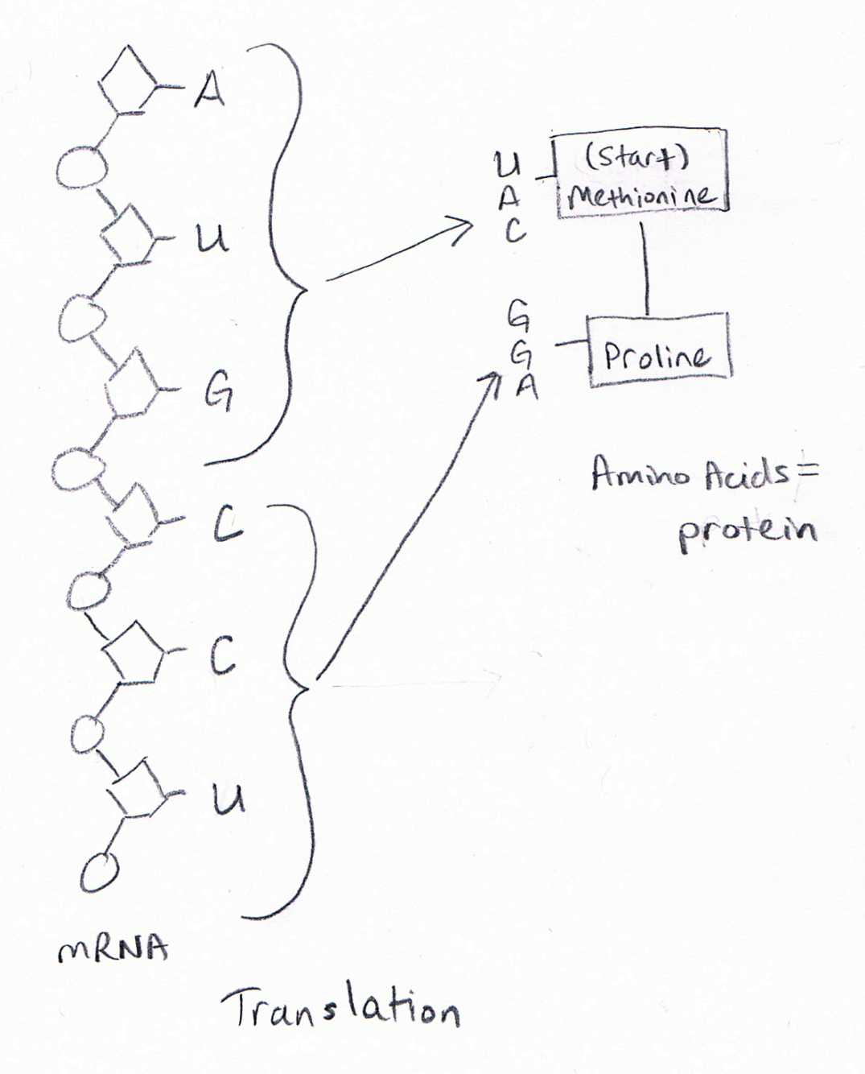
Translation
Session 3
tRNA with Amino Acid
Ribosome ‘reads’ the mRNA
Every 3 bases is called a CODON and equals ONE amino acid.
Amino acids are linked together to form a protein.
Drawing by S. Spencer (April 2013)

Slide 12
Oops! Mistakes Happen!
Session 3
Mutation – Any change in the genetic code
Original mRNA
C A U G G U A U C C C G A G
HIST
GLY
ISO
PRO
Deletion
C A U G G U A U C C C G A G
C A U G G U U C C C G A G
HIST
GLY
SER
PRO
Insertion
C A U G G U A U C U C C G A G
HIST
GLY
ISO
SER
GLUT
Substitution
C A U C G U A U C C C G A G
HIST
ARG
ISO
PRO

Slide 13
DNA to Genes to Inheritance
Session 3
Proteins are made from the DNA code. Sections of the DNA code are known as GENES. The proteins allow the GENE to be expressed as a TRAIT with different ALLELES.
DNA
Chromosome
Trait
(Characteristic)
Alleles
(Different forms of the characteristic)
A
A
T
T
T
C
A
G
G
A
G
C
C
T
T
A
C
C
C
G
E
N
E 1
Pea Plant Color Yellow (Y) or Green (y)
G
E
N
E 2
Pea Plant Height Tall (T) or short (t)

Slide 14
The Father of Genetics
Session 3
Mendel
Gave us the terms Dominant and Recessive
*Most traits have a DOMINANT form and a RECESSIVE
form.
*DOMINANT is represented by a CAPITAL letter;
recessive is represented by a lowercase letter
*For example – for HEIGHT of a pea plant
Tall is dominant and represented with a capital T
Short is recessive and represented with a lowercase t

Slide 15
The Law of Dominance
Session 3
We get one set of chromosomes from mom and one set from dad – SOOO we have TWO copies of each gene!
Ex. Color of Pea Seeds
YY Yellow
Yy Yellow
yy green
_____________ ______________
Genotype (in the genes) Phenotype (physical appearance)
Recessive only shows when paired with another recessive!

Slide 16
Punnett Squares
Session 3
A shorthand way to predict possible offspring for a set of parents.
 | Y | y
Y | YY | Yy
y | Yy | yy
Parent 1
Parent 2
Possible offspring
Genotype: 1 YY : 2 Yy : 1yy
Phenotype: 3 yellow : 1 green

Slide 17
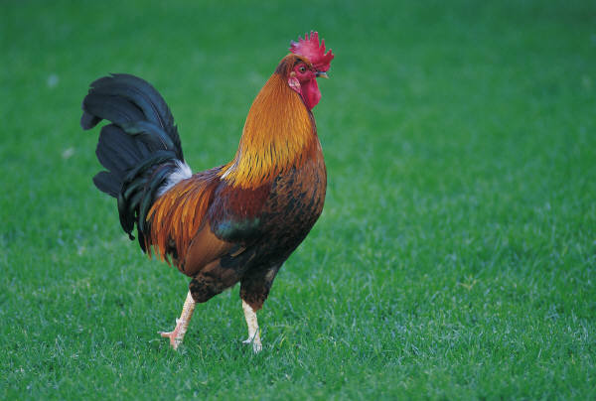
Exceptions to Mendel’s Laws
(i.e. other forms of inheritance)
Session 3
Codominance – TWO dominant alleles (both show)
(ex: chicken feathers)
Multiple Alleles – more than 2 forms of a trait
(ex: Blood type has 3 alleles – A, B, and O)

Slide 18
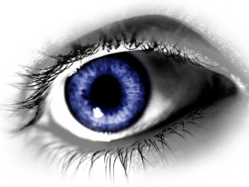
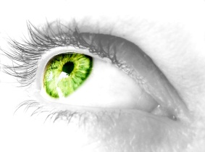
More Exceptions to Mendel’s Laws
(i.e. other forms of inheritance)
Session 3
Polygenic – multiple genes control a single trait
(ex: eye color, skin color)
Sex Linked – trait is linked to a sex chromosome (usually the X chromosome)
Remember: Boys = XY, Girls = XX

Slide 19


A closer LOOK at Sex-Linked
Session 3
 | X | X
X | XX (Girl) | XX (Girl)
Y | XY (Boy) | XY (Boy)
mom
Example: Hair (H) or Baldness (h)
 | X^{H} | X^{h}
X^{H} | X^{H}X^{H} | X^{H}X^{h}
Y | X^{H}Y | X^{h}Y
Dad
Phenotype Possibilities:
2 girls w/hair : 1 boy w/hair : 1 boy bald

Slide 20
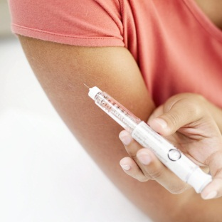
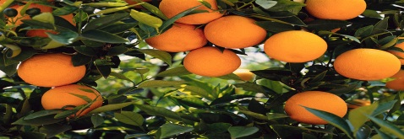
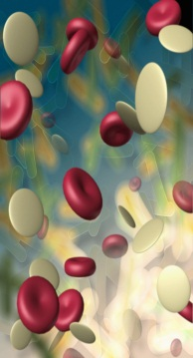
Should we or Shouldn’t we??
Biotechnology
Session 3
Genetic Engineering – direct changing of an organism’s DNA (gene therapy & GMOs)
Cloning – making an identical copy of an organism
Stem Cells – manipulating undifferentiated cells to become specific cell types like nerves
‘Designer’ Babies – using technology to
select fertilized eggs with desirable traits

