Slide 1
Biology EOC Review
Session 4: Ecology
Created by S. Spencer (April 2013)
All images are Microsoft Clipart used with permission from Microsoft, Inc, unless otherwise noted.

Slide 2
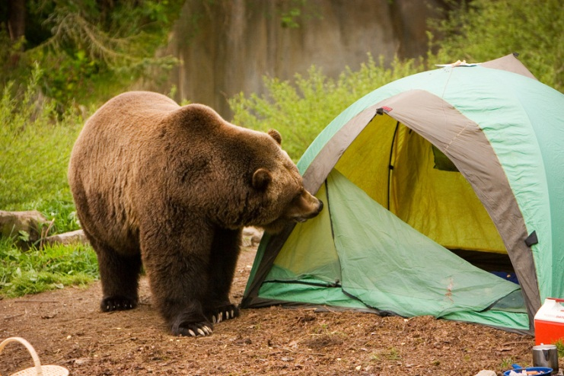
It’s All Interrelated!
Session 4
Organisms & Environment, Environment & Organisms – they are all interconnected!
ABIOTIC – nonliving
BIOTIC – living
*both affect a population’s carrying capacity! (# of individuals)

Slide 3

Cycling of Water
Session 4
condensation
transpiration
precipitation
evaporation
Run off

Slide 4
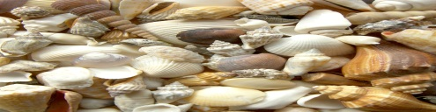
Cycling of Carbon
Session 4
Fossil fuel burning
photosynthesis
Respiration
Sediment & Weathering

Slide 5
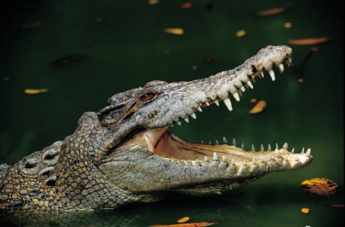
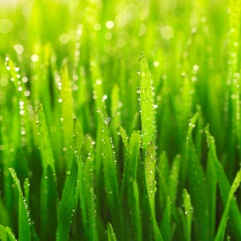

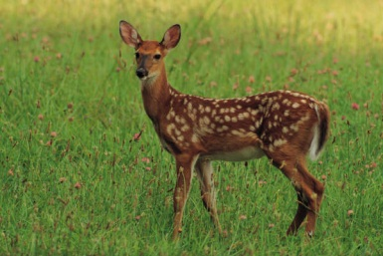
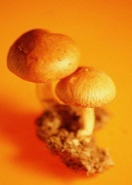
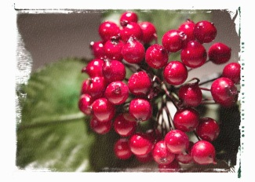
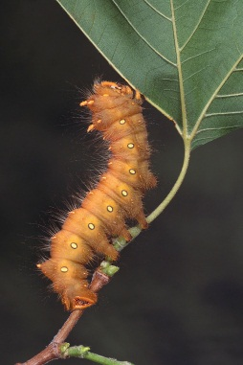
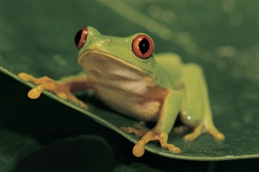
Cycling of Organic Matter & Energy Through Living Things
Session 4

Slide 6



Session 4
0.1%
Tertiary Consumer
Secondary Consumer
1%
10%
Primary Consumer
Producer
100%
*Only 10% of available energy is actually passed on from one level to the next!

Slide 7
How Organisms Interact: Symbiosis
Session 4
Mutualism
Commensalism
Parasitism
Predator/Prey

Slide 8
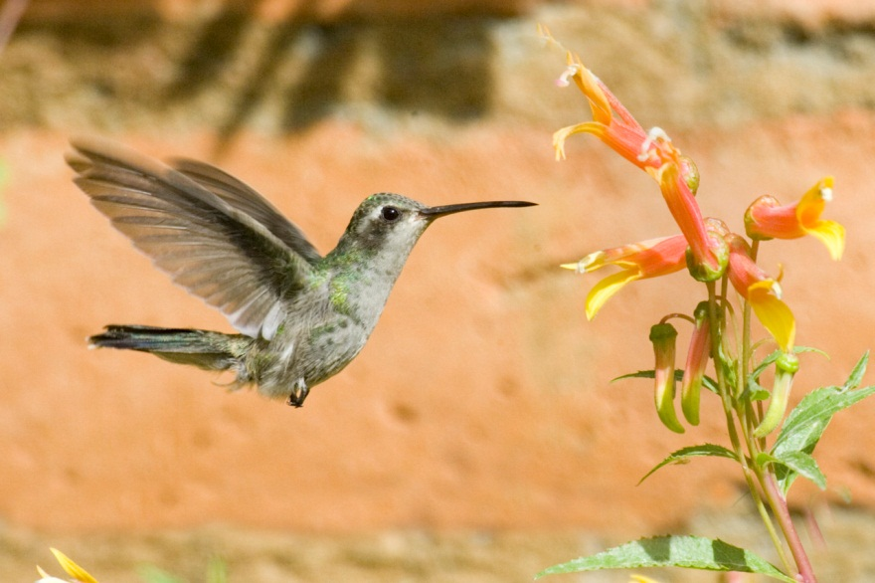
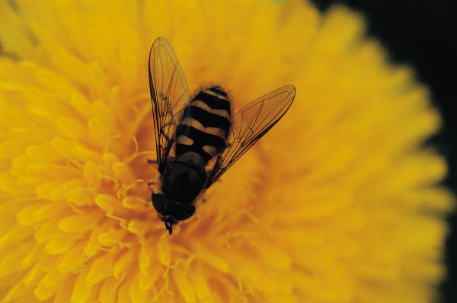
Mutualism
Session 4
BOTH organisms BENEFIT!

Slide 9
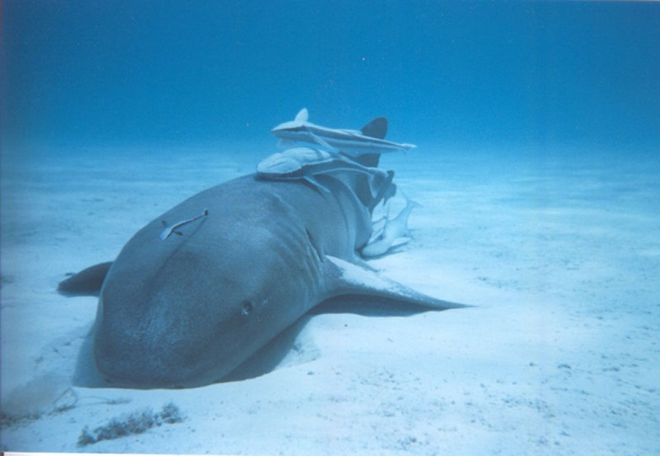
Commensalism
Session 4
ONE organism benefits and ONE organism is neither harmed nor benefited!
Public Domain Image (CC0)

Slide 10
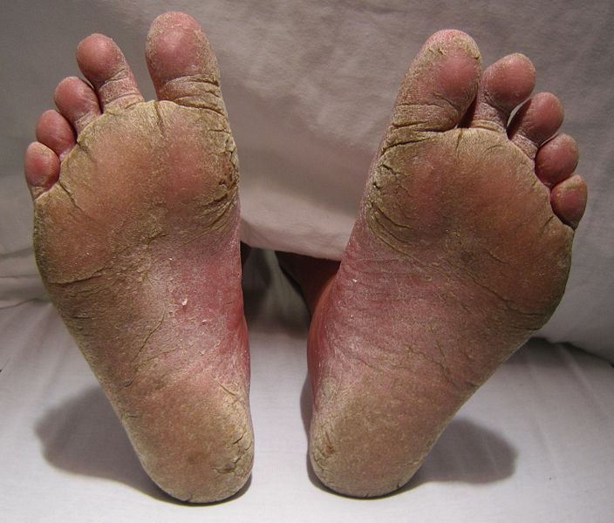
Parasitism
Session 4
ONE organism benefits and ONE organism is harmed!
Public Domain Image (CC0)

Slide 11
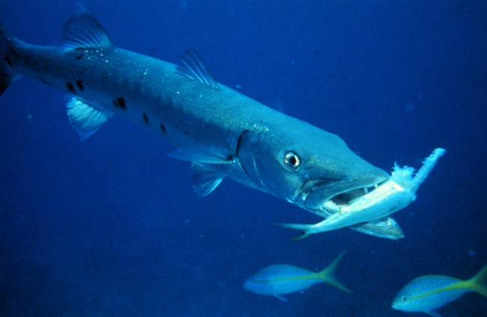
Predator/Prey
Session 4
ONE organism benefits and ONE organism is killed!
Public Domain Image (CC0)

Slide 12
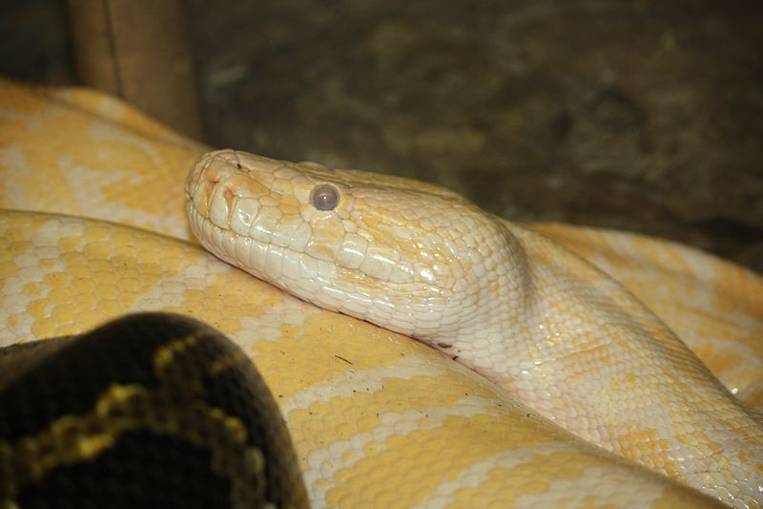
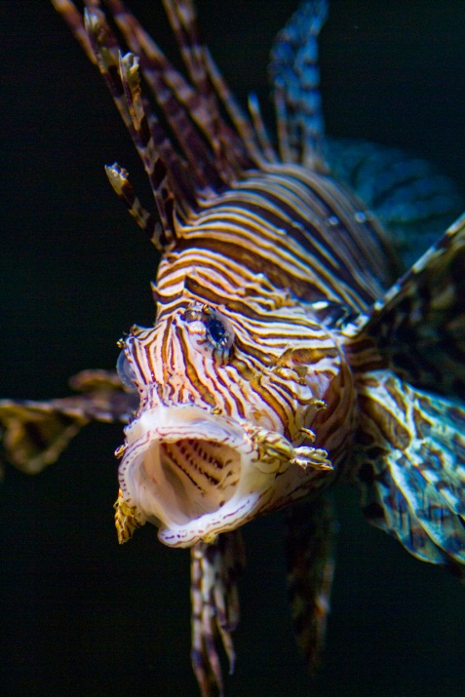
Human Impact
Session 4
Invasive Species
introduction of new organisms to area
Public Domain Image (CC0)

Slide 13
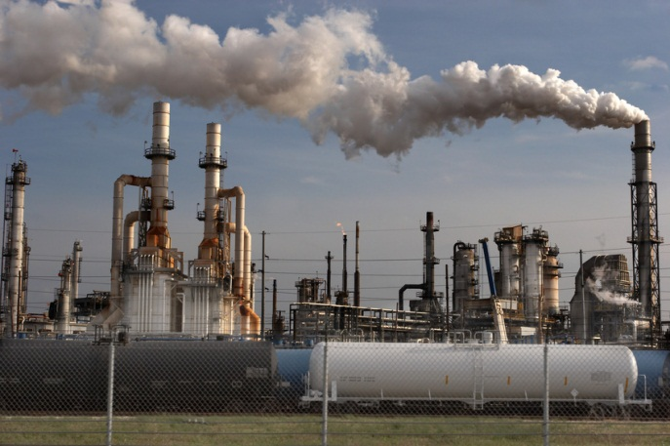

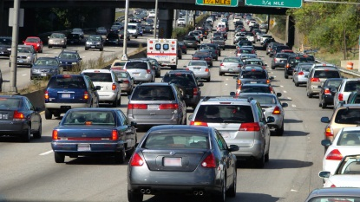
Human Impact
Session 4
Global Warming
Increase in Earth’s average surface temperature

Slide 14
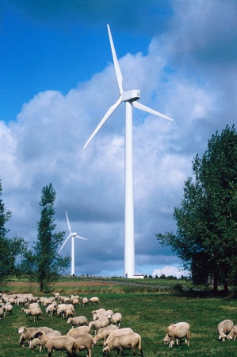
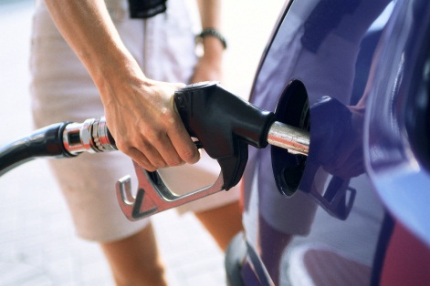
Human Impact
Session 4
Do Your Part!
Renewable resources –can be replenished over time (wind, solar, trees, fish)
Nonrenewable resources – cannot be replenished; limited amount (gasoline, oil, coal)

