Slide 1
Chapter 34
Endocrine and
Reproductive Systems
34.3
The Reproductive System
SC.912.L.16.13
Describe the basic anatomy and physiology of the human reproductive system. Describe the process of human development from fertilization to birth and major changes that occur in each trimester of pregnancy.

Slide 2
34.3 The Reproductive System
Key Questions
What effects do estrogens and testosterone have on females and males?
What are the main functions of the male reproductive system?
What are the main functions of the female reproductive system?
What are some of the most commonly reported sexually transmitted diseases?
Vocabulary
Puberty semen
Testis ovary
Scrotum menstrual cycle
Seminiferous tubule ovulation
Epididymis corpus luteum
Vas deferens menstuation
sexually transmitted disease
Pages 988 - 994

Slide 3
34.3 The Reproductive System
Sexual Development
What effects do estrogens and testosterone have on females and males?
Male and female embryos are nearly identical in appearance up to the seventh week of development.
The male and female reproductive systems begin to develop differently.
  Male reproductive development is triggered by the production of testosterone in the gonads of the embryo.
  Female reproductive development develops under the influence of estrogen produced in the embryo’s gonads and does not utilize testosterone
  In females, the effects of the sex hormones include breast development and a widening of the hips.
  In males, they result in the growth of facial hair, increased muscular development, and deepening of the voice.

Slide 4
34.3 The Reproductive System
Sexual Development
In early childhood, the gonads and adrenal cortex produce low levels of sex hormones that influence development.
Neither the testes or the ovaries can produce active reproductive cells until puberty.
Puberty is a period of rapid growth and sexual maturation during which the reproductive system becomes fully functional.
Puberty occurs in most males between 9 and 15 and usually begins one year earlier in females.
Puberty actually begins in the brain when the hypothalamus signals the pituitary to produce two hormones that affect the gonads: follicle-stimulating hormone (FSH) and luteinizing hormone (LH).

Slide 5
34.3 The Reproductive System
The Male Reproductive System
What are the main functions of the male reproductive system?
    Testosterone causes the male physical changes associated with puberty and., together with follicle-stimulating hormone (FSH).
    When puberty is complete, the reproductive system is fully functional, meaning that the male can produce and release active sperm.
    Just before birth, the primary male reproductive organs, the testes, descend from the abdomen into an external sac called the scrotum.
    The testes remain in the scrotum, outside of the body cavity, where the temperature is a few degrees lower than in the body cavity.
    The lower temperature is important for proper sperm development

Slide 6
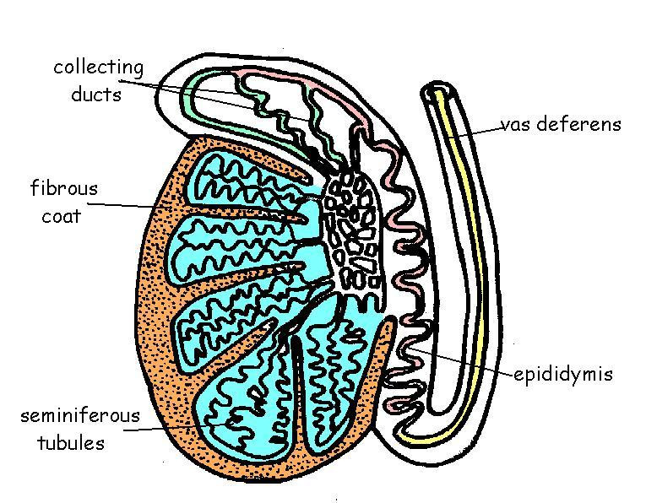
34.3 The Reproductive System
The Male Reproductive System
Sperm Development
Within each testis are clusters of hundreds of tiny tubules called seminiferous tubules where sperm develop.
Specialized diploid cells within the tubules undergoes meiosis and form the haploid nuclei of mature sperm. The haploid cell contains only a single set of chromosomes.
Sperm are then moved into the epididymis where they are stored.
From the epididymis, some sperm are moved to the vas deferens, which extends upward from the scrotum to the abdominal cavity. The vas deferens eventually merges with the urethra, the tube that leads to the outside of the body through the penis.

Slide 7
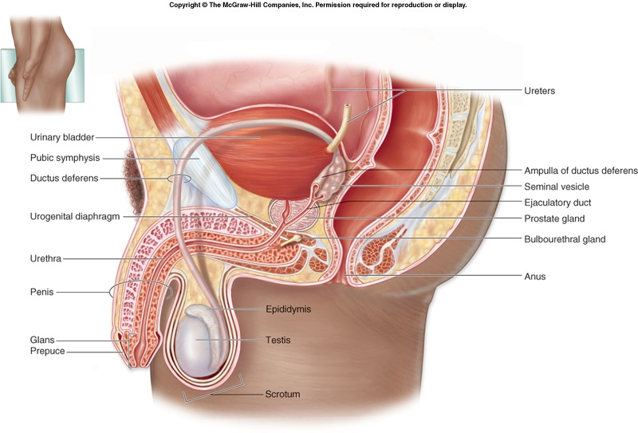
34.3 The Reproductive System
The Male Reproductive System

Slide 8
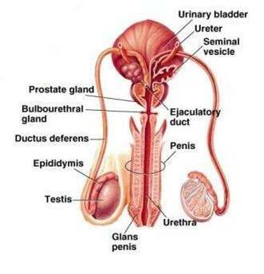
34.3 The Reproductive System
The Male Reproductive System
Sperm Development
Glands lining the reproductive tract – including the seminal vesicles, the prostate, and the bulbourethral glands – produce a nutrient enriched fluid called seminal fluid.
The seminal fluid nourishes the sperm and protects them from the acidity of the female reproductive tract.
The combination of sperm and seminal fluid is known as semen.
The number of sperm present in a drop of semen is about 2.5 million.
About 2 to 6 milliliters of semen are released in an average ejaculation. If the sperm are released in the reproductive tract of a female, the chances of a single sperm fertilizing an egg are very good, if an egg is available.

Slide 9
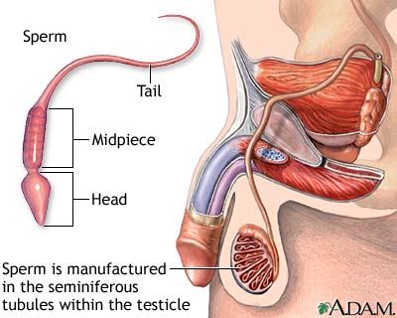
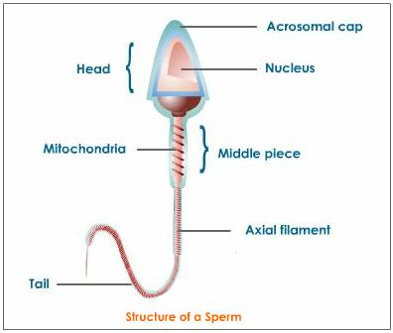
34.3 The Reproductive System
The Male Reproductive System
Structure of Sperm

Slide 10
34.3 The Reproductive System
The Female Reproductive System
What are the main functions of the female reproductive system?
Primary reproductive organs of the female are the ovaries
During puberty, the hypothalmus signals the pituitary gland to release FSH and LH. FSH stimulates cells within the ovaries to produce increased amounts of estrogens and to start producing egg cells.
The main focus of the female reproductive system is to produce egg cells, or ova. In addition, the system prepares the female’s body to nourish a developing embryo.

Slide 11
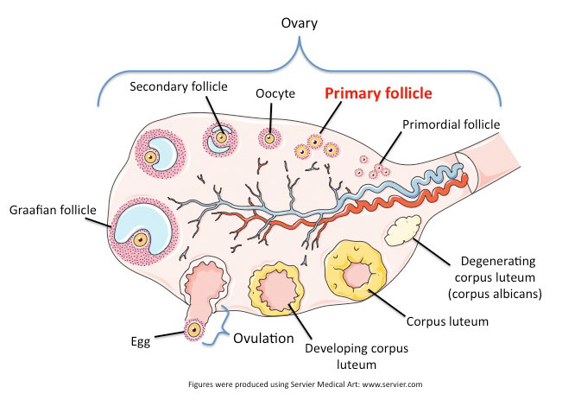
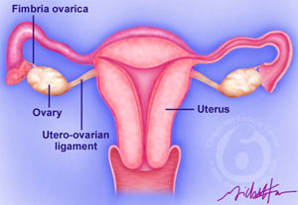
34.3 The Reproductive System
The Female Reproductive System
Female Reproductive Structures
Primary follicles surrounding a single egg helping it mature for release into the reproductive tract, where it may be fertilized
Ovaries

Slide 12
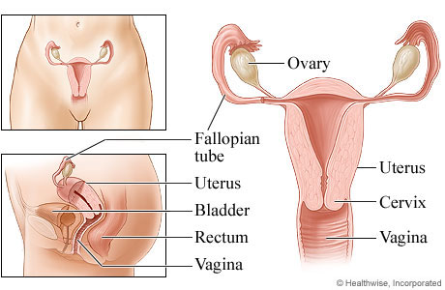
34.3 The Reproductive System
The Female Reproductive System
Female Reproductive Structures

Slide 13
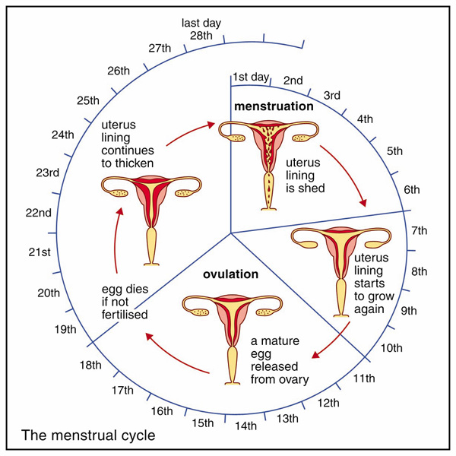
34.3 The Reproductive System
The Female Reproductive System
The Menstrual Cycle
One ovary usually produces and releases one mature ovum every 28 days or so.
The process of egg formation and release occurs as part of the menstrual cycle, a regular sequence of events involving the ovaries, the lining of the uterus, and the endocrine system. It is regulated by hormones made by the hypothalamus, pituitary, and ovaries.
During the menstrual cycle, an egg develops within a follicle and is released from an ovary. The uterus is prepared to receive the fertilized egg. If the egg is not fertilized, it is discharged along with the lining of the uterus.
If the egg is fertilized, embryonic development begins and the menstrual cycle ceases.
The menstrual cycle includes the follicular phase, ovulation, luteal phase, and menstruation.

Slide 14
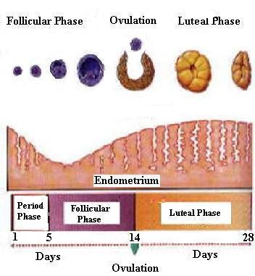
34.3 The Reproductive System
The Female Reproductive System
The Menstrual Cycle
Follicle phase
  Blood estrogen levels are low
  Hypothalamus releases hormone to stimulate the anterior pituitary to secrete FSH and LH
  These hormones travel to the ovaries where they cause a follicle to mature
  As the follicle develops, the cells surrounding the egg enlarge and produce increased amounts of estrogen. This causes the lining of the uterus to thicken
  Development of the egg during this phase takes about 12 days
Ovulation
  As the follicle grows, more estrogen is released.
  Hypothalamus reacts to increased hormones by triggering a burst of LH and FSH from anterior pituitary.
  The sudden increase in hormones causes the follicle to rupture
  The result is ovulation, the release of the egg from the ovary into one of the Fallopian tubes.
  When released, the egg is stalled in metaphase of meiosis II and will remain that way unless it is fertilized
Luteal Phase
  As the egg moves through the Fallopian tube, the cells of the ruptured follicle change; the follicle turns yellow and is now know as the corpus luteum; it releases estrogens but also begins to release progesterone, which stimulates the growth and development of the blood supply and surrounding tissue in the thickening uterine lining
  If fertilization does not occur, the corpus luteum will degenerate and a new follicle phase begins
Menstruation
  At the start of a new follicle phase, low estrogen levels cause the lining of the uterus to detach . This tissue along with blood and the unfertilized egg are discharged through the vagina. which is called menstruation. This phase lasts 3-7 days

Slide 15
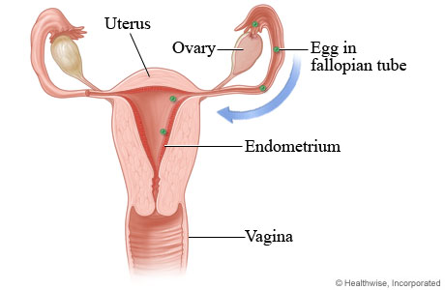
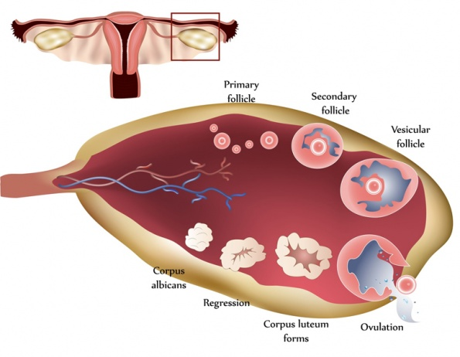
34.3 The Reproductive System
The Female Reproductive System
Ovulation – Egg released from ovary into Fallopian tube

Slide 16
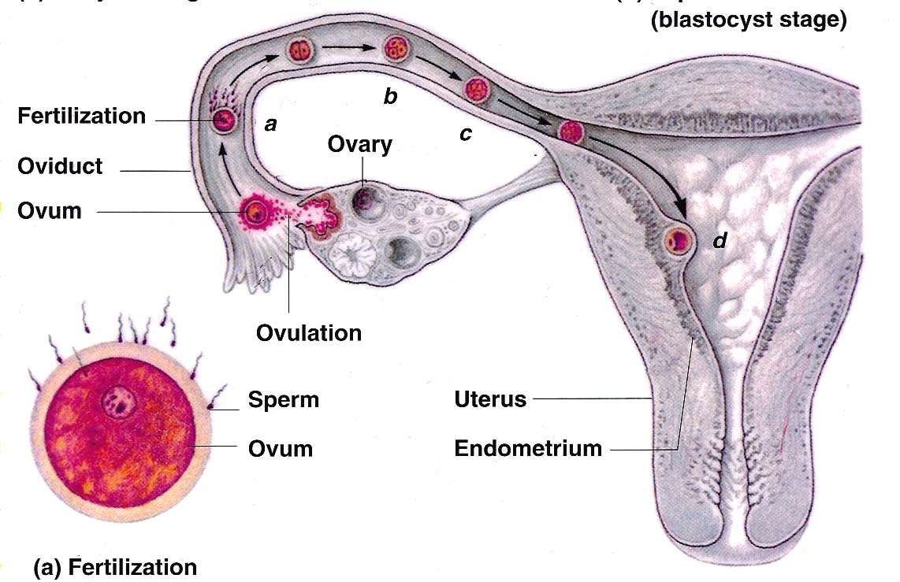
34.3 The Reproductive System
The Female Reproductive System
PREGNANCY – The fertilization of the egg and its implantation into the uterus

Slide 17
34.3 The Reproductive System
The Female Reproductive System
Sexually Transmitted Diseases
What are some of the most commonly reported sexually transmitted diseases?
According to a 2008 study done by the Centers for Disease Control and Prevention, 1 in 4 young women aged 14-14 WERE infected with an STD.
Chlamydia is not only the most common bacterial STD, it is the most commonly reported bacterial disease in the United States. Chlamydia is a bacterium spread by sexual contact and can damage the reproductive tract and lead to infertility.
Other bacterial STDs include gonorrhea and syphilis. Bacterial STDs can be treated with antibiotics.
Viral STDs include hepatitis B, genital herpes, genital warts, and AIDs. These viral infections cannot be treated with antibiotics.

Slide 18
34.3 Assessment (p. 994)
1a. Review Explain what happens during puberty.
1b. Compare and Contrast Compare and contrast the sexual development of male embryos to that of female embryos.
2a. Review Describe the function of the male reproductive system.
2b. Sequence Explain how sperm develop.
3a. Review Describe the function of the female reproductive system.
3b. Interpret visuals What happens during each stage of the menstrual cycle? Hint: Refer to Figure
34-14
4a. Review Name two STDs caused by bacteria and two caused by viruses.
4b. Evaluate Why do you think that young people are especially at risk for STDs?

Slide 19
Chapter 34
Endocrine and
Reproductive Systems
34.4
Fertilization and Development
SC.912.L.16.13
Describe the basic anatomy and physiology of the human reproductive system. Describe the process of human development from fertilization to birth and major changes that occur in each trimester of pregnancy.

Slide 20
34.4 Fertilization and Development
Key Questions
What takes place during fertilization and the early stages of human development?
What important events occur during the later stages of human development?
Vocabulary
Zygote Neurulation
Blastocyst Placenta
Implantation Fetus
Gastrulation
Pages 995 - 1001

Slide 21
34.4 The Reproductive System
Fertilization and Development
Fertilization and Early Development
What takes place during fertilization and the early stages of human development?
The fusion of a sperm and egg cell is called fertilization.
Hundreds of millions of sperm are released when semen is ejaculated into the vagina. Sperm then swim through the uterus into the Fallopian tubes.
If an egg is present in the Fallopian tubes, its chances of being fertilized are good. The egg has a protective layer that contains binding sites.
The sperm releases enzymes that break down the protective layer. The haploid sperm nucleus enters the haploid egg and chromosomes from the sperm and egg are brought together.
Once the two haploid nuclei fuse, a single diploid nucleus is formed, containing a single set of chromosomes from each parent cell. The fertilized egg is called a zygote.

Slide 22
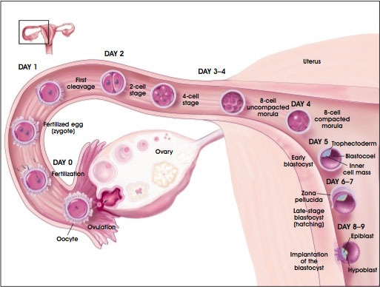
34.4 The Reproductive System
Fertilization and Development
Fertilization

Slide 23
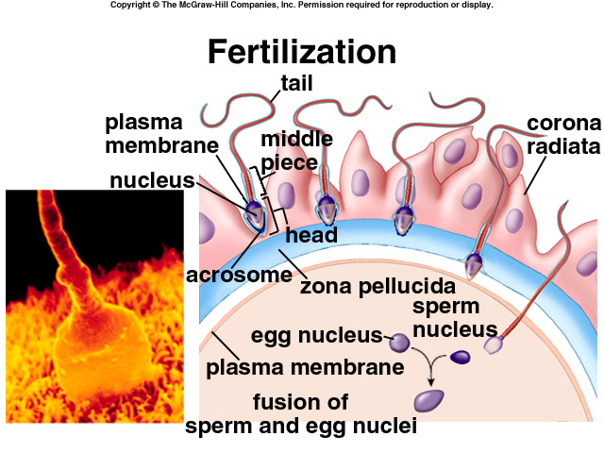
34.4 The Reproductive System
Fertilization and Development

Slide 24
34.4 The Reproductive System
Fertilization and Development
Once a single sperm enters the egg and fertilization takes place, the egg reacts by forming a barrier that prevents other sperm from entering.

Slide 25
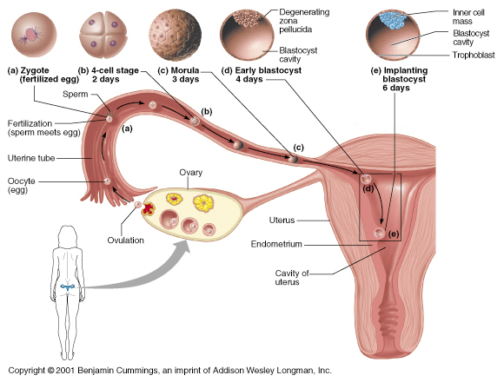
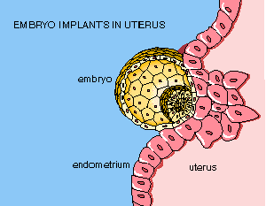
34.4 The Reproductive System
Fertilization and Development
Embryonic Implantation
Implantation – Blastocyst attaches to the wall of the uterus
Blastocyst – cavity in a ball of cells containing the embryo

Slide 26
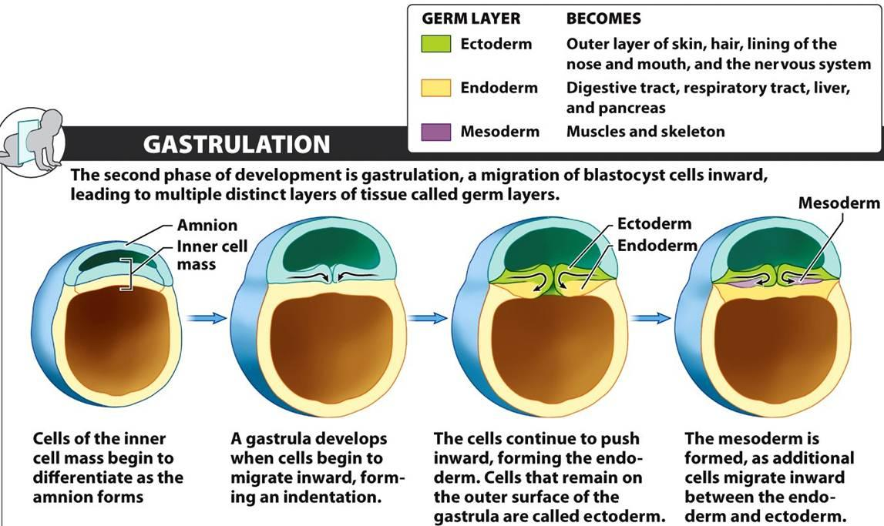
34.4 The Reproductive System
Fertilization and Development
Gastrulation

Slide 27
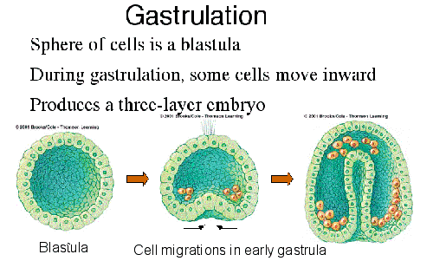
34.4 The Reproductive System
Fertilization and Development
Gastrulation

Slide 28
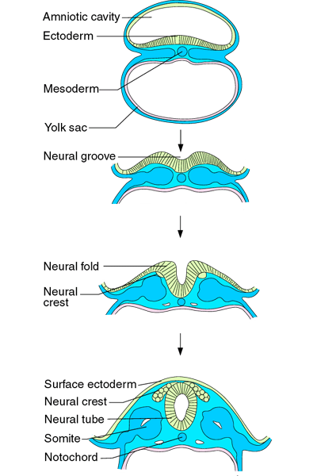
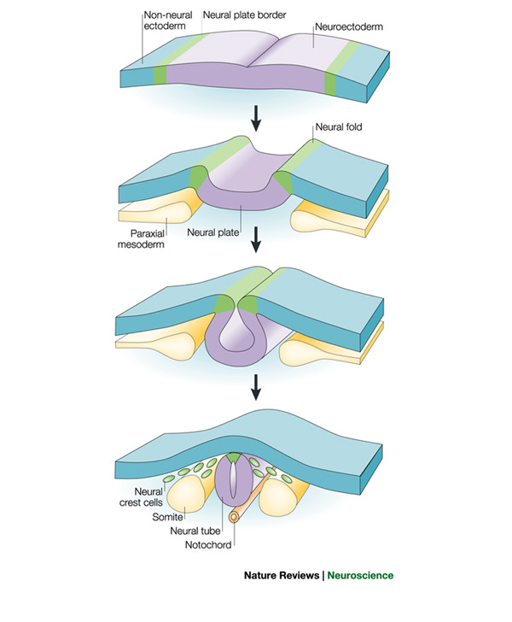
34.4 The Reproductive System
Fertilization and Development
Neurulation
Neurulation is the first step in the development of the nervous system.
A block of mesodermal tissue begins to differentiate into the notochord.
As the notochord develops, the ectoderm near the notochord thickens and forms the neural plate.
The neural folds gradually move together and form the neural tube, from which the spinal cord and brain will develop.
Cells of the neural crest migrate to other locations and become types of nerve cells, skin pigment cells, and other structures.

Slide 29
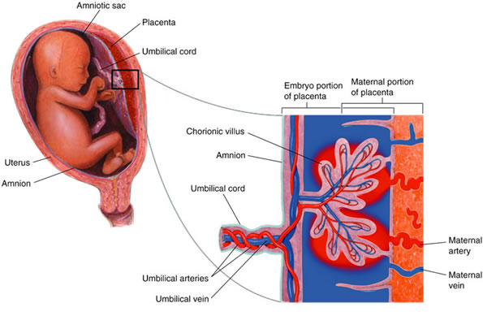
34.4 The Reproductive System
Fertilization and Development
The Placenta
The placenta is the connection between the mother and the embryo that acts as the embryo’s organ of respiration, nourishment, and excretion.
Across a thin barrier, oxygen and nutrients diffuse from the mother’s blood to the embryo’s blood and carbon dioxide and wastes diffuse from the embryo’s blood to the mother’s blood.
The umbilical cord, which contains two arteries and one vein, connects the embryo to the placenta.

Slide 30
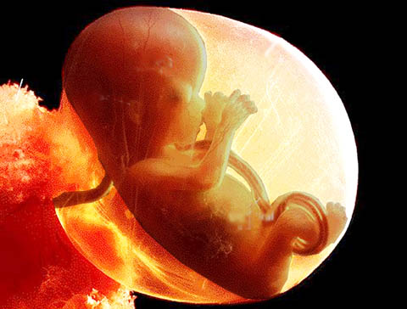
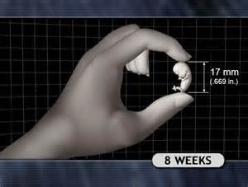
34.4 The Reproductive System
Fertilization and Development
The Fetus at 8 Weeks
After 8 weeks of development, the embryo is called a fetus. By the end of 3 months, most of the major organs and tissues of the fetus are fully formed. The fetus may begin to move and show signs of reflexes. The fetus is about 8 centimeters long and has a mass of about 28 grams.

Slide 31
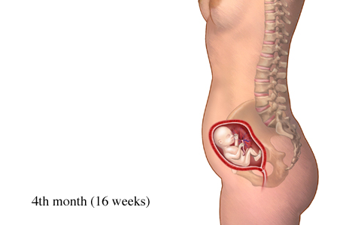
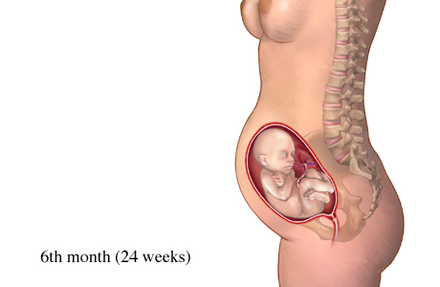
34.4 The Reproductive System
Fertilization and Development
The Fetus at 4 – 6 months

Slide 32
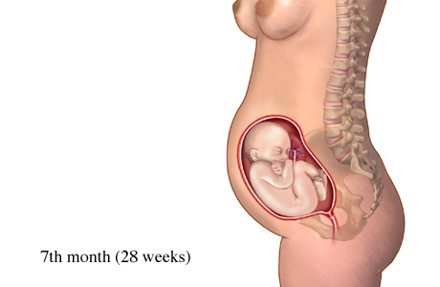
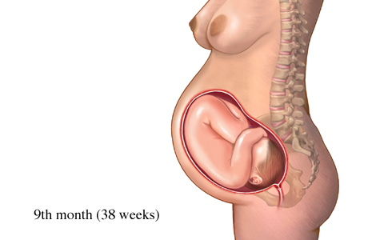
34.4 The Reproductive System
Fertilization and Development
The Fetus at 7 – 9 months

Slide 33
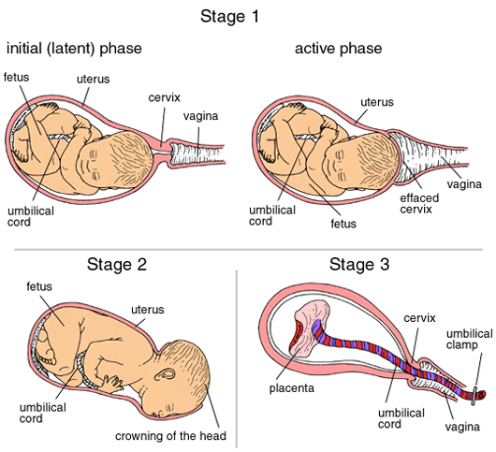
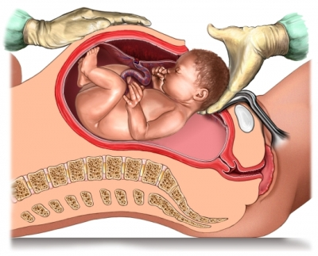
34.4 The Reproductive System
Fertilization and Development
Childbirth
Caesarian Section delivery
Normal Vaginal delivery.

Slide 34
Chapter 31
Nervous System
31.2
The Central Nervous System
SC.912.L.14.26
Identify the major parts of the brain on diagrams or models
SC.912.L.14.6
Explain the significance of genetic factors, environmental factors, and pathogenic agents to health from the perspective of both individual and public health.

Slide 35
31.2 The Central Nervous System
Key Questions
Where does processing of information occur in the nervous system ?
How do drugs change the brain and lead to addiction?
Vocabulary
Reflex Hypothalamus
Cerebrum Cerebellum
Cerebral cortex Brain stem
Thalamus Dopamine
Pages 901 - 905

Slide 36
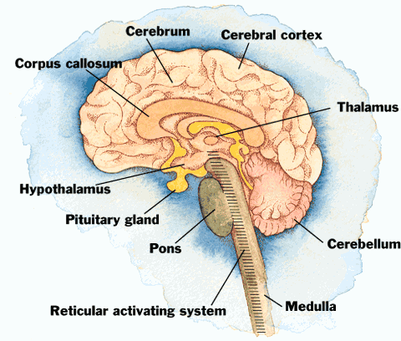
31.2 The Central Nervous System
The Brain and Spinal Cord
Each of the major areas of the brain – the cerebrum, cerebellum, and the brain stem – are responsible for processing and relaying information.
The spinal cord is the main communication link between the brain and the rest of the body.
A reflex is a quick, automatic response to a stimulus. The way you pull your hand back quickly when pricked by a pin or when you touch something extremely hot are examples of a reflex.

Slide 37
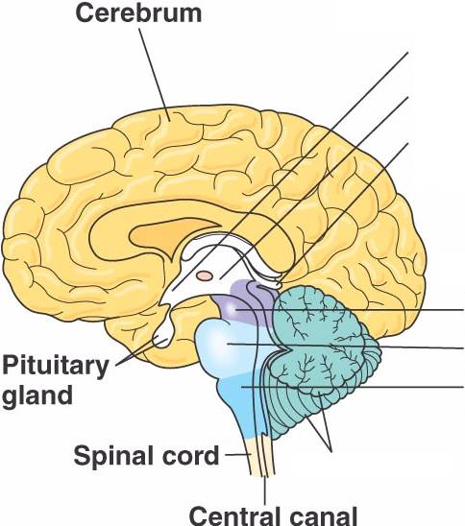
31.2 The Central Nervous System
The Brain and Spinal Cord
The cerebrum is the largest region of the human brain.
The cerebrum is responsible for the voluntary, or conscious, activities of the body.
It is also the site of intelligence, learning, and judgment.

Slide 38
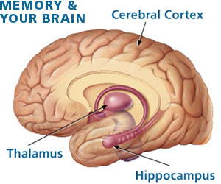
31.2 The Central Nervous System
The Brain and Spinal Cord
The cerebral cortex is the outer layer of the cerebrum. It consists of densely packed nerve cell bodies known as gray matter.
The cerebral cortex processes information from the sense organs and controls body movements.
It is also where thoughts, plans, and learning abilities are processed.

Slide 39
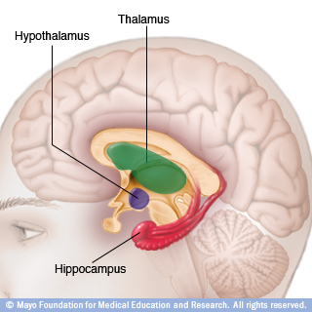
31.2 The Central Nervous System
The Brain and Spinal Cord
The thalamus receives messages from sensory receptors throughout the body and then relays the information to the proper region of the cerebrum for further processing.
The hypothalamus is the control center for recognition and analysis of hunger, thirst, fatigue, anger, and body temperature. It also helps to coordinate the nervous and endocrine systems.

Slide 40
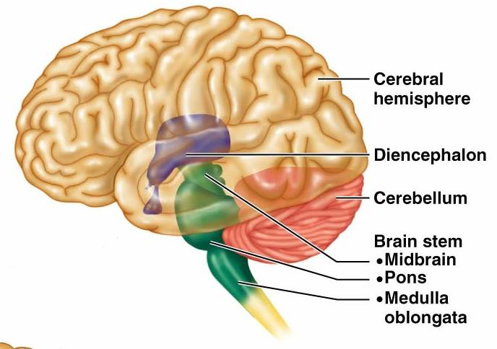
31.2 The Central Nervous System
The Brain and Spinal Cord
The cerebellum is the second largest region of the brain.
Information about muscle and joint position, as well as other sensory inputs, are sent to the cerebellum.
The brain stem connects the brain and the spinal cord. The brain stem includes three regions – the midbrain, the pons, and the medulla oblongata.

Slide 41
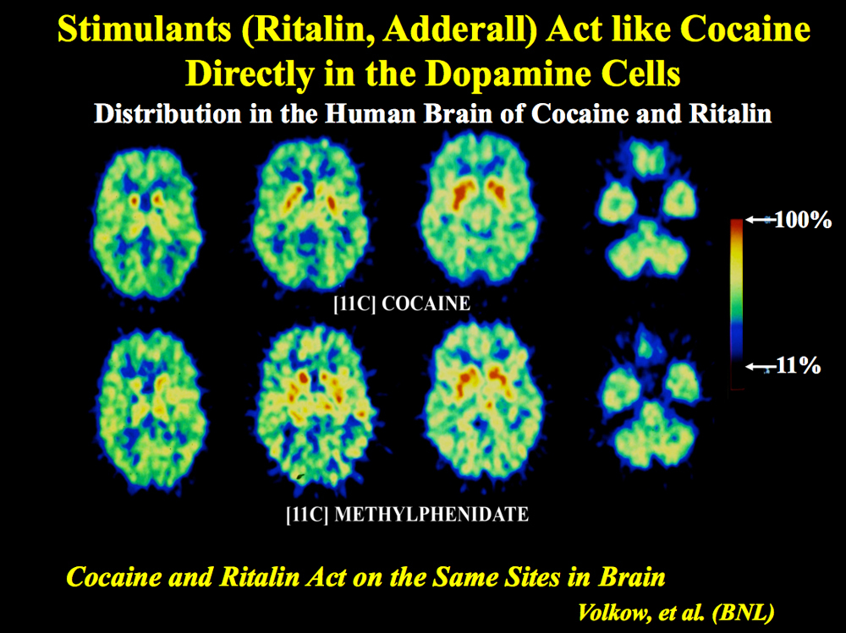
31.2 The Central Nervous System
The Brain and Spinal Cord

Slide 42
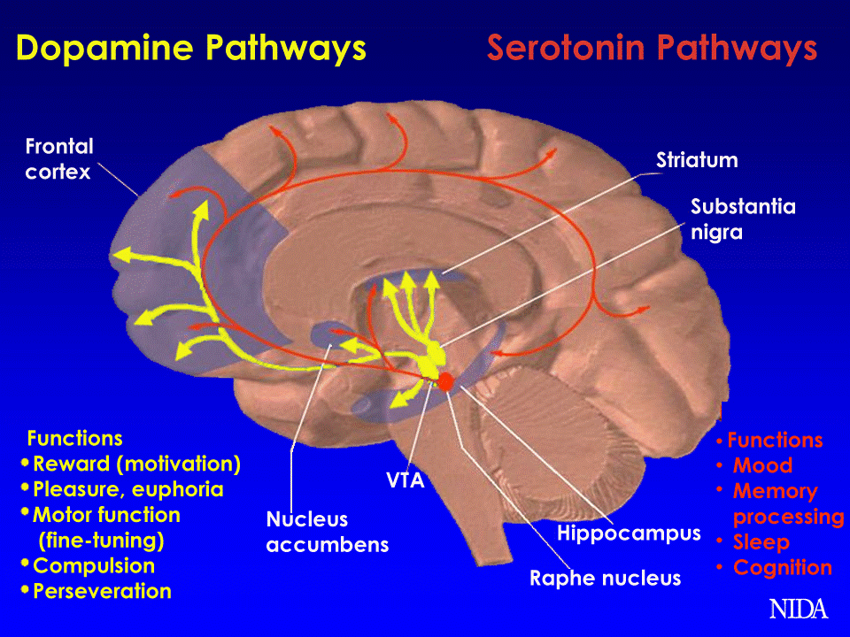
31.2 The Central Nervous System
The Brain and Spinal Cord
The brain reacts to excessive dopamine levels by reducing the number of receptors for the neurotransmitter. As a result, normal activities no longer produce sensations of pleasure they once did. Because there are fewer receptors, larger amounts of tobacco, alcohol, and illegal drugs are required to produce the same “high”.

